Slide 1
Welcome to Genetics: Human Aspects! – BIOL 101 (Online)
What you’ll learn: The molecular basis of physical traits, human disease, and life as we know it.
Contact information
Professors: Dr. Chris DeFraia (Lecture, Lab for section VL-1)
Dr. Gary Miller (Lab for section VL-2)
email: defraic@ferris.edu
phone: Not available by phone, but I check email often.
Zoom classroom: See Zoom link on the left-hand menu in Canvas
When is class?
Class will be held on Zoom (see above):
All students: Tuesdays: 9:30 AM – 10:45 AM. Use Tuesday meeting zoom link
Section VL-1 students: Thursdays: 9:30 AM – 10:45 AM. Use section VL-1 zoom link
Section VL-2 students: Thursdays: 9:30 AM – 10:45 AM. Use section VL-2 zoom link
What will you do during class times?
On Tuesdays you will:
Ask any questions you have about the lecture videos
Complete an online lab and any associated activities
On Thursdays you will:
View my lecture videos on Canvas
Take notes on the videos and submit them via Canvas
Work on homework questions, in groups if you like.
What will you do outside of class times?
Homework (if not finished during class), due most Tuesdays on Canvas
Correct your homework (for full credit!) and submit on Canvas
How much time can you expect to spend this class per week?*
Lecture videos and notes: 2.0 hrs
Homework: 2.0 hrs
Online lab and lab zoom meeting-2.0 hrs
Cats love genetics.
Questions? Here are some answers…
~6 hours total/week
*Not including studying for exams

Slide 2
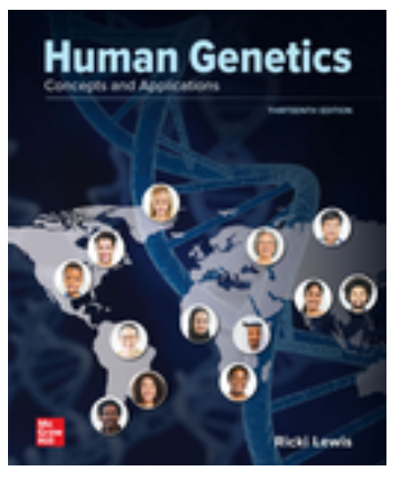
What’s the textbook? Human Genetics 13 edition, by Lewis (e-text only). You will get the electronic text when you register and pay for McGraw-Hill Connect. For a better price, do this through Canvas or the bookstore.
Don’t buy the paper textbook!
Homework: HW is closely based on the videos, but will require you to think and problem-solve. All HW questions for the semester are in the HW packet on Canvas. Copying HW answers from someone else is easily detectable, even if you change the wording. And anyway, questions you miss can be corrected later for full credit, so getting questions wrong is OK. In fact, it’s a good way to learn.
Exams: We will have three online exams (not cumulative). I have set up the online exams to make cheating both difficult and easily detectable.
Grades: Your final grade will come from HW, exams, and the final exam. All grades will be posted on Canvas.
93 – 100% A
90 – 92.9% A-
87 – 89.9% B+
83 – 86.9% B
80 – 82.9% B-
77 – 79.9% C+
73 – 76.9% C
70 – 72.9% C-
67 – 69.9% D+
63 – 66.9% D
60 – 62.9% D-
< 60% F
Exams: 100 pts x 3 = 300 pts
Labs: 15 pts x 11 = 165 pts
HW: 10 pts x 11 = 110 pts
Vid. Notes: 5 pts x 11 = 55 pts
Total class points = 615 pts*
*Subject to change
What if I submit HW late? Late HW is a zero with the following exceptions: Illness (with a Dr’s note) or bereavement (with an obituary). You can always turn in HW early.
Is there extra credit? No, but you can get 100% of the lab points by completing them, nearly 100% of the HW points by correcting questions you miss, and 100% of the points from the lecture notes by completing and submitting them. That’s half of all available points where you can have near 100%.
Want help? No problem! If something is preventing you from doing well in this class I urge you to chat with me. I want you to do well. If you need accommodations to do your best work, contact disability services in Starr 313. You’re legally entitled to them and I want to give them to you.
If I copy HW answers will I get caught? Possibly. I give out several zeros each semester for plagiarism of HW, which is a bummer ☹. A second occurrence will result in failure of the course. For my full policy see page 41 of the FSU Handbook.

Slide 3
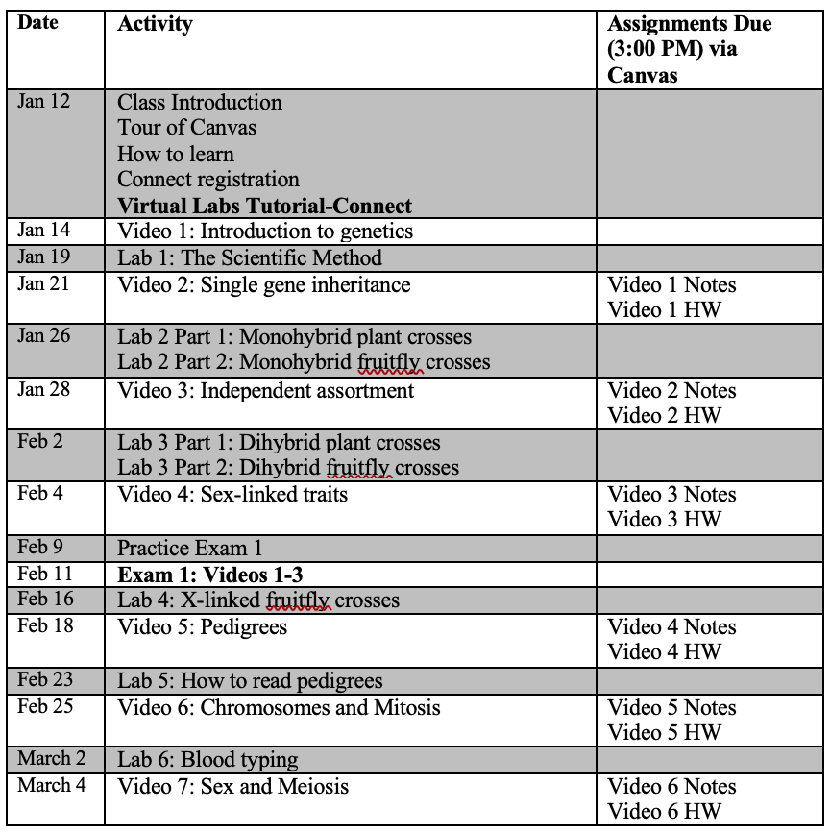
Class Schedule – BIOL 101

Slide 4
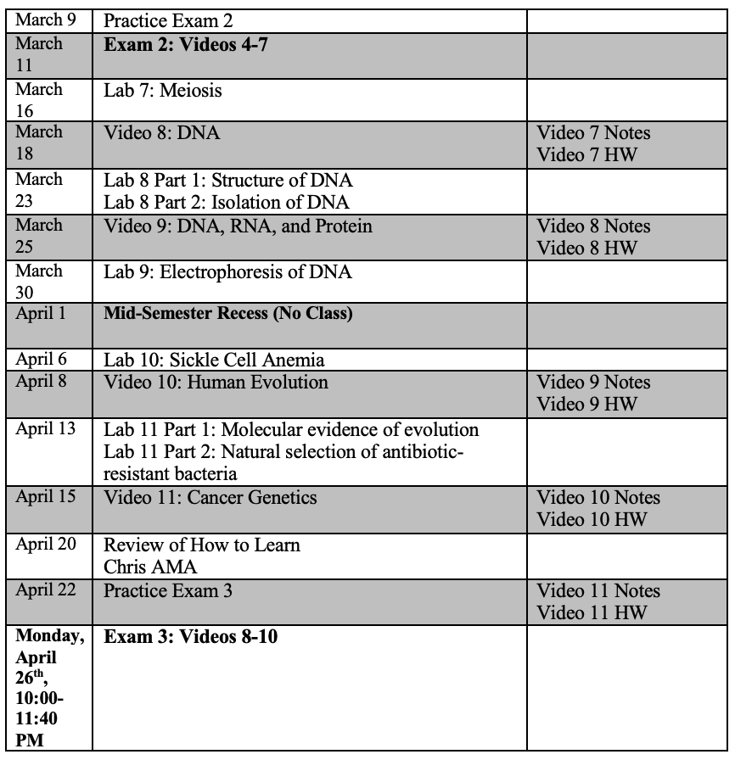
Class Schedule – BIOL 101

