Slide 1


Welcome to Current Topics in Biology! – BIOL 460 Syllabus
What you’ll learn: How to understand, evaluate, and communicate scientific literature, and a few other useful skills. In short, how to be a professional.
Professor: Chris DeFraia
Where and when to be there:
T, Th 3:00-3:50 SCI 137
email: defraic@ferris.edu
phone: 231-591-2509
office: ASC 2018
office hours: Tue 1:30-2:50 in STR 134
Thur 4:00-6:00 in SCI 137 or by appointment
.
“Somewhere, something incredible is waiting to be known.”
Carl Sagan
What you’ll read:
1) Gillen, C.M. 2007. Reading Primary Literature: A Practical Guide to Evaluating Research Articles in Biology, Pearson Benjamin Cummings.
2) Nine research articles and associated reading.
3) Readings in the course-pack
What class will be like: I’ll spend part of the class teaching you how to read and communicate research papers. You will spend most of the rest of the course reading, summarizing, and presenting papers.
What you’ll do outside of class: 1) Assigned readings. 2) Several assignments (listed below). Each assignment is described in detail in the course assignments packet.
Assignment Points
Summary #2 citations 25
Weekly Write-ups (25 pts each) 150
Job application: 100
Paper summary #1: 100
Paper summary #2: 100
Data summary activity: 25
Paper Presentation 100
Assignment Points
Peer review of proposals: 25
Paper summary activity: 25
Research proposal: 200
Proposal presentation 50
Biology reflection statement: 25
Class participation 50
Blackboard quizzes 60
Total 1035
When are assignments due? Usually at the beginning of class, either as a paper copy or through blackboard. A few assignments are due on non-class days. See the class schedule for all due dates.
Can you hand in assignments late? No, unless you have a illness or school event with a note from your Dr’s office/coach/instructor.

Slide 2
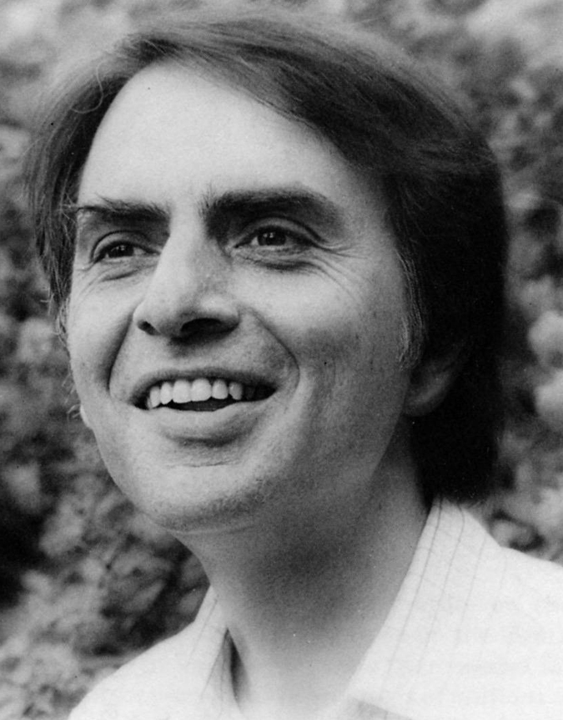
Grades: Your final grade will come from HW, exams, and the final exam. All grades will be posted on blackboard.
Grading Scale
93 – 100% A
90 – 92.9% A-
87 – 89.9% B+
83 – 86.9% B
80 – 82.9% B-
77 – 79.9% C+
Extra credit: There is no extra credit offered for this course, with the exception of letter’s you’ll write to next year’s class.
73 – 76.9% C
70 – 72.9% C-
67 – 69.9% D+
63 – 66.9% D
60 – 62.9% D-
< 60% F
Need help? No problem! If something is preventing you from doing well in this class I urge you to come speak with me. I want you to do well. If you need accommodations to do your best work, contact disability services in Starr 313. Accommodation will never result in a lower grade.
Plagarism on an assignment will result in a zero. A second occurrence will result in failure of the course. For my full policy see page 41 of the Ferris State University Student Handbook.
Showing up: I do not take attendance, but missing class will make this course much more difficult.
What you’ll be able to do: At the end of this course you will be able to find, understand, and communicate the latest advances in biology, and you will have significantly improved your scientific writing skills. You will also be able to choose a field of research, identify open questions, and write an original research proposal addressing one of those questions. In short, you will have the skills of a biologist.
How to do well in this course
1) Hand in all work on time. No late work is accepted.
2) Ask questions! It’s the best way to learn. There are no dumb questions.
3) Come to office hours for clarification of my comments on your writing. Sometimes a short conversation is more helpful than a lot of red ink.
4) Complete all readings carefully. They will help immensely when completing your assignments.
5) Help each other! Read each other’s work and provide feedback, but be careful to avoid plagarism.
A personal note: It is my hope that at the end of this class you will no longer think of yourself as a student, but as a professional who is capable of learning almost anything in biology on their own.
“Science is more than a body of knowledge. It is a way of thinking, a way of skeptically interrogating the universe.”
-Carl Sagan

Slide 3
Class Schedule – BIOL 460
Changes to the schedule: I may make small changes to the class schedule in case of university closings or other events.

Slide 4
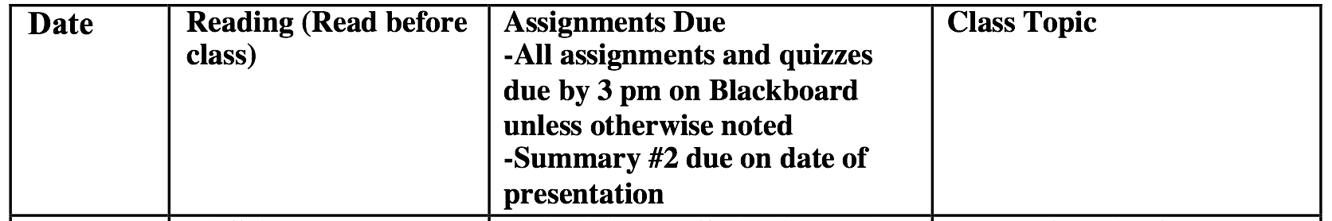
Class Schedule – BIOL 460

