Slide 1
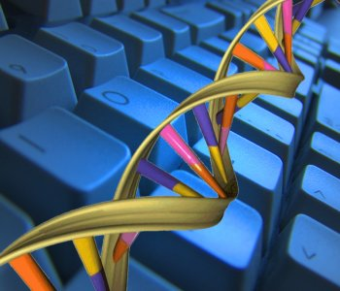
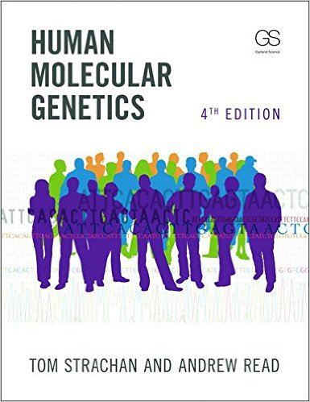
Welcome to Bioinformatics! – BIOL 475 Syllabus
What you’ll learn: How to analyze DNA sequences of human genes and interpret the results in the context of human genetic disease.
Professor: Chris DeFraia
Where and when to be there:
Mon, Wed 9:00-10:15 ATC 176
email: defraic@ferris.edu
phone: 231-591-2509
office: ASC 2018
office hours: M: 10:15-11:30 ATC 176
What you’ll read:
1) Human Molecular Genetics 4th Edition, T. Strachan and A. Read, Garland Science, 2011. ISBN: 978-0815341499.
2) Several guides on how to use bioinformatic programs.
What class will be like: A mixture of powerpoint slides and tutorials on how to use bioinformatic programs. You’ll spend a lot of class time using these programs to analyze DNA sequences. No food or drinks in the classroom.
What you’ll do outside of class: 1) Read the textbook and study the figures that cover the day’s material before coming to class. The class schedule tells you what you need to read for each class. 2) Homework, and lots of it! HW is the most important part of this class. Some HW problems will only require looking up information. Others will require you to think and apply what you’ve learned. Still others will require you to analyze DNA sequences using bioinformatic programs. Your goal should be to learn 100% of the material. To this end you may correct your HW and recover any missed points.
When is HW due? Beginning of class on days indicated in the class schedule.
Can you hand in HW late? No, unless you have a illness or school event with a note from your Dr’s office/coach/instructor. Incomplete assignments may not be corrected for credit.
You should do this!
Exams: We will have two in-class exams (not cumulative) that will cover both theoretical aspects of the class and the use of bioinformatic programs. They will be taken on the computers in class.

Slide 2
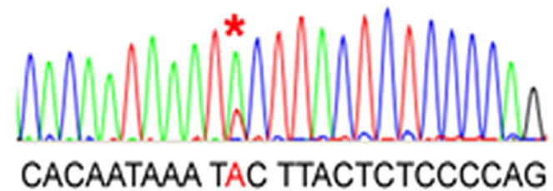
Grades: Your final grade will come from HW, exams, and the final exam. All grades will be posted on blackboard.
Grading Scale
93 – 100% A
90 – 92.9% A-
87 – 89.9% B+
83 – 86.9% B
80 – 82.9% B-
77 – 79.9% C+
Assessment Points
Exams 200 (100 points each)
Final project 100
Oral presentation: 25
Homework 175 (25 points each)
Total Points Available: 500
73 – 76.9% C
70 – 72.9% C-
67 – 69.9% D+
63 – 66.9% D
60 – 62.9% D-
< 60% F
You can get 100% of the HW points!
Extra credit: There is no extra credit with the exception of a letter you will write to next year’s students at the end of the semester.
Need help? No problem! If something is preventing you from doing well in this class I urge you to come speak with me. I want you to do well. If you need accomodations to do your best work, contact disability servics in Starr 313. Accomodation will never result in a lower grade.
Cheating on an exam or plagarism of homework will result in a zero. A second occurrence will result in failure of the course. For my full policy see page 41 of the Ferris State University Student Handbook.
Showing up: I do not take attendance, but it will be very difficult to learn how to use the programs if you are absent.
How to do well in this course
1) Do not miss class, especially classes that deal wtih bioinformatic programs.
2) Do the assigned readings before each class. They make the lecture much easier to understand.
3) Submit HW on time. No late HW is accepted.
4) Ask questions! It’s the best way to learn. There are no dumb questions.
5) When studying for the exam, study the
lecture slides, your class notes,
and HW questions.
5) Correct all HWs before
taking the exam that
covers that material.

Slide 3
Class Schedule – BIOL 475
Changes to the schedule: I may make small changes to the class schedule in case of university closings or variation in the time taken to cover topics.

Slide 4
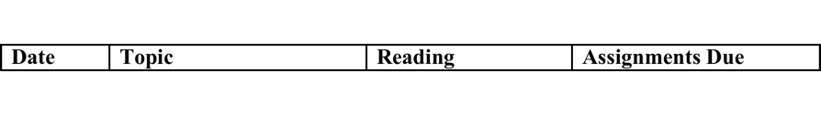
Class Schedule – BIOL 475

